Slide 1
What Is To Be Learned
William Labov
University of Pennsylvania
NELS 2010
Notes:
My paper today is an effort to define the target of the language learner: asking, what are the data that the child attends to in the process of becoming a native speaker? In so doing, we will necessarily be engaged in the more general effort to define language itself. The argument to be advanced here is that the human language learning capacity is aimed at the acquisition of the most general community pattern. The end result is a high degree of uniformity in both the categorical and variable aspects of language production, where individual variation is reduced below the level of linguistic significance.

Slide 2

www.ling.upenn.edu/~labov
Notes:
I don’t have a handout, but I’ve put this PowerPoint, with the text in full, on my home page under the section on PowerPoints of recent presentations.

Slide 3
The central dogma of sociolinguistics:
The community is conceptually and analytically prior to the individual.
In linguistic analysis, the system mof an individual can be understood only through the study of the social groups of which he or she is a member.
Notes:
This paper will support what I call the central dogma of sociolinguistics CLICK that the community is conceptually and analytically prior to the individual. CLICK This means that in linguistic analysis, the behavior of an individual can be understood only through the study of the social groups of which he or she is a member. Following the approach outlined in Weinreich et al. 1968, language is seen as an abstract pattern located in the speech community and exterior to the individual.

Slide 4
Durkheim’s social facts
. . .ways of behaving, thinking and feeling, exterior to the individual, which possess a power of coercion by which they are imposed on him (Durkheim 1937, Règles de la méthode sociologique, p. 5, my translation)
Notes:
Language is a social fact, in Durkheim’s terms-- ways of behaving, thinking and feeling, exterior to the individual, which possess a power of coercion by which they are imposed on him
. The human language faculty, an evolutionary development rooted in human physiology, is then viewed as the capacity to perceive, reproduce and employ such generalized patterns.
The opposing view, well established in the thinking of many students of the speech community, is that the individual constructs an idiolectal grammar on the basis of the particular set of input data to which he or she is exposed in the formative years. Since in this view, the language learning mechanism is not programmed to delete idiosyncratic constructs, the end result is that each learner winds up with a particular version of the grammar based on individual experience. The speech community is then seen as a vague average or assembly of these idiolectal variants.
This enthusiasm for the individual is not a new development.

Slide 5
Durkheim on individualism
“. . . the word compelling, by which we define [social facts], has a risk of irritating the zealous partisans of an absolute individualism. As they believe that the individual is perfectly autonomous, they feel that the individual is diminished each time that it seems that he does not act entirely by himself. (Durkheim 1937:6).
Notes:
So Durkheim notes,. “the word compelling, by which we define [social facts], has a risk of irritating the zealous partisans of an absolute individualism. As they believe that the individual is perfectly autonomous, they feel that the individual is diminished each time that it seems that he does not act entirely by himself”
Although the critique of the idiolect in Weinreich, Labov and Herzog 1968 was widely accepted, the desire to focus on the individual recurs with striking regularity, even among sociolinguists.

Slide 6
The individual as primary input
“The linguist should be able to pin-point the development of a language as a result of individual choices, and . . . the sociolinguist should try to relate changes in social structure to changes in individual cultural values as expressed through speech in social interaction. Individual behavior is thus seen as the proper starting point for sociolinguistic investigation.”
–Janet Holmes, Sociolinguistics and the Individual
Notes:
So in Janet Holmes on Sociolinguistics and the Individual, writes
“The linguist should be able to pin-point the development of a language as a result of individual choices, and . . . the sociolinguist should try to relate changes in social structure to changes in individual cultural values as expressed through speech in social interaction. Individual behavior is thus seen as the proper starting point for sociolinguistic investigation.
Similarly, Hymes 1979 would give “foundational status” to individual differences as a vantage point from which to study language in general. Le Page and Tabouret Keller (1985) see language as essentially idiosyncratic. Language is for them the linguistic repertoire of the individual; the individual is “the locus of his language.” (P. 116). Johnstone’s book on The Sociolinguistic Individual (1996) is devoted to the argument that we should think about language from the perspective of the individual speaker, rather than the perspective of the social aggregate or the abstract linguistic system

Slide 7
The general perspective put forward here. . .
Notes:
The general perspective put forward here reinforces the contrary view. It is argued that the individual does not exist as a unit of linguistic analysis. Though the recordings and judgments of sociolinguistic research are gathered from individual speakers, their idiosyncratic behavior is not our focus, but rather the extent to which they respond to wider community patterns.
The compulsion for the language learner to turn outward may be thought of as the end result of a competition between two types of language learning.
In one type each individual forms a grammar that is informed primarily by the initial input and is the unique product of his or her individual experience.
The other type is programmed to keep smoothing the result with data from following contacts (up to a certain limit). This second type is outwardly bound, in the sense that it searches for the community pattern as epistemologically prior to the individual pattern.
The suggestion here is that from an evolutionary point of view, the second type will survive, and has survived, at the expense of the first

Slide 8
Two opposing views of the role of individuals and groups in natural selection
Chapters 5 to 8 [of Adaptation and Natural Selection] will be primarily a defense of the thesis that group-related adaptations do not, in fact, exist.
The fact that an insect population survives through a succession of generations is not evidence for the existence of biotic adaptation. The survival of the population may be merely an incidental consequence of the organic adaptations by which each insect attempts to survive and reproduce itself.
-- G.C. Williams. 1966. Princeton U. Press. >
Natural selection can operate simultaneously at more than one level. Individual selection promotes the fitness of others relative to others in the same group. Group selection promotes the fitness of groups, relative to other groups in the global population. . . . A notion of group-interest must be added to the notion of self-interest, to the extent that group selection is important in nature.
--David Sloan Wilson. 1989. Levels of Selection: An Alternative to Individualism In Biology and the Human Sciences. Social Networks 11:257-72.
Notes:
The issue of individual vs. group evolution is very much alive in evolutionary biology. The argument that natural selection operates only on the level of the individual is best known through Dawkins the Selfish Gene, but the case was stated most forcefully by G. C. Williams book, Adaptation and Natural Selection.
Chapters 5 to 8 [of Adaptation and Natural Selection] will be primarily a defense of the thesis that group-related adaptations do not, in fact, exist.
The fact that an insect population survives through a succession of generations is not evidence for the existence of biotic adaptation. The survival of the population may be merely an incidental consequence of the organic adaptations by which each insect attempts to survive and reproduce itself.
. It appears that individualist view is still the dominant position in biology. The explanation of altruistic behavior in the animal kingdom has carried the argument further, where the concept of inclusive fitness is used to explain the evolution of altruistic actions that favor kin who share the same genes,
However, arguments for multiple levels of selection continue to be heard, as in the work of David Sloan Wilson
Natural selection can operate simultaneously at more than one level. Individual selection promotes the fitness of others relative to others in the same group. Group selection promotes the fitness of groups, relative to other groups in the global population. . . . A notion of group-interest must be added to the notion of self-interest, to the extent that group selection is important in nature.
More recently attention has been given to the equations developed by W. D. Hamilton and George Price, which describe evolution at the level of the gene, the organism and the group—the population of organisms. It is not my intention to pursue this argument here, but rather to lay out the evidence that supports the priority of the group in linguistic development.

Slide 9
Part 1. The rejection of the idiolect.
Notes:
Part 1 of my effort in this direction deals with the rejection of the idiolect by children. I am sure that most everyone in this room has personal evidence that children to not adopt those features of their parents’ dialect that do not match the surrounding community. Linguists are especially conscious of such mismatches with their parents or with their children. For my general argument, I will want to go beyond this personal experience and consider the most systematic studies of this process.

Slide 10
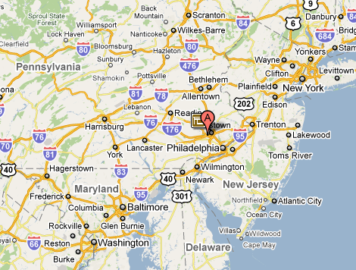
King of Prussia, PA . . .
Notes:
Our best view of how children reject of their parents’ dialect can be drawn from that part of the Philadelphia Neighborhood Study designed by Arvilla Payne in the new town of King of Prussia. In this middle class town, which barely existed after in the 1940s, half of the population came from metropolitan Philadelphia and half from out-of-state communities with very different vowel systems: Massachusetts, New York, Cleveland.

Slide 11
Acquisition of Philadelphia variables by 34 children of out-of-state families in King of Prussia by age of arrival
Age of arrival
from Payne 1976
Notes:
Payne’s study included the acquisition of the Philadelphia dialect by 34 children of out-of-state parents. In this diagram, the vertical axis is the percent of children who consistently rejected their parents’ dialect in favor of the Philadelphia pattern. From left to right we have the [CLICK]fronting of [ao] to [eo], [CLICK] the centralization of [like, right, fight] before voiceless consonants,[CLICK] the fronting of the nucleus of go,[CLICK] the raising of the nucleus of oy in choice, and [CLICK] the fronting of /uw/ in [diu[.
The majority of children who spent at least half of their formative years in Philadelphia departed from their parents’ pattern consistently—those who came from birth to 4 and from 5 to 9. Those who came later did not, except for the fronting of /ow/. But conversely it should be noted that a third at least still showed some traces of the parental system.

Slide 12
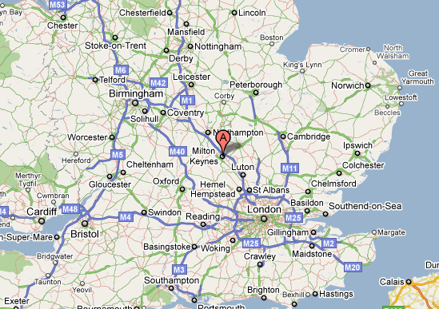
Milton Keynes. . .
Notes:
A second study of a new town was Kerswill and Williams’ research in Milton Keynes, composed of inmigrants from many different areas of England (Williams and Kerswill 1999, Kerswill and Williams 2000). Milton Keynes did not exist in 1971, but grew to 176,000 in 1991. Three quarters of its residents came from the southeastern England: 35% from London, 32% from other southern counties, but only 3% from the immediate sub-region within 15 minutes drive. This project was elegantly and carefully designed to record the phonology of 8 boys and 8 girls at each of three age levels: 4, 8 and 12 years old, together with the caretakers of each, a total of 96 speakers. [The new Milton Keynes dialect that arose was a distinct entity. combining the some features of London and the home counties with some remnants of the local dialect ]

Slide 13
Development of local phonetic forms for the GOAT vowel in Milton Keynes by age. [From Kerswill and Williams 1994].
Notes:
Kerswill and Williams provide this profile for the development of /ow/, the GOAT vowel, across three age levels of children together with the mean scores for their female caretakers. The horizontal axis shows the frequencies of three variants: front nuclei with unrounded glides as in gaeit, front nuclei with rounded glides as in gaeüt, and back upgliding vowels with a central or back glide, gout, goüt. [CLICK] [CLICK] The four-year-olds have clearly not departed from the pattern of their parents and caretakers.. [CLICK] [CLICK] But the eight and twelve-year-olds have, shifting massively to the front nuclei with rounded glides. Clearly the eight year olds no longer take their parents’ vowel systems as the target for language learning.
.

Slide 14
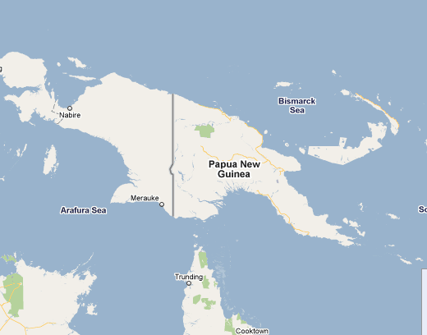
kk……
Notes:
A dramatic view of the disconnect between parents and children is found when a pidgin language, with no native speakers shifts to a creole as a generation of children grow up with this as their first language. [Bickerton treats these as linguistically orphaned, forced to use their naked language learning ability from scratch because they do not recognize their parents speech as legitimate language.]

Slide 15
Reduction of future bai ( < baimbai) in Tok Pisin
Parent Child
em bai i-go em b-i-go
he will go he will go
Notes:
Sankoff studied this process in the development of the future marker BAI of Tok Pisin. Adults tended to give this formative secondary stress, realizing ‘He will go’ as /em bai i-go/, while children tended to reduce /bai/ to [bə] in [embəigo] or even [embigo].

Slide 16
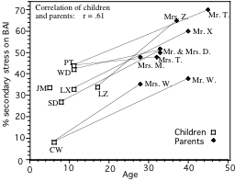
Percent secondary stress on future marker BAI by parents and children (source: G. Sankoff).
Notes:
This figure shows the maintenance of secondary stress of bai on the vertical axis with age on the horizontal axis. As a whole, parents are very different from their children:
35 to 70% bai with and children at much lower levels: 5 to 45%.. However, the lines connecting parents to children remain parallel, indicating that parental differential input is maintained even when children have absorbed the new community norms.

Slide 17
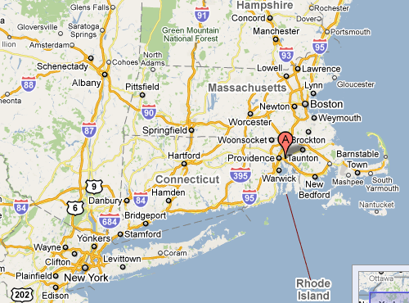
Seekonk MA . . .
Notes:
Children’s acquisition of a new change can also be observed quite clearly in Johnson’s study of the spread of the low back merger in eastern Massachusetts (2010).

Slide 18
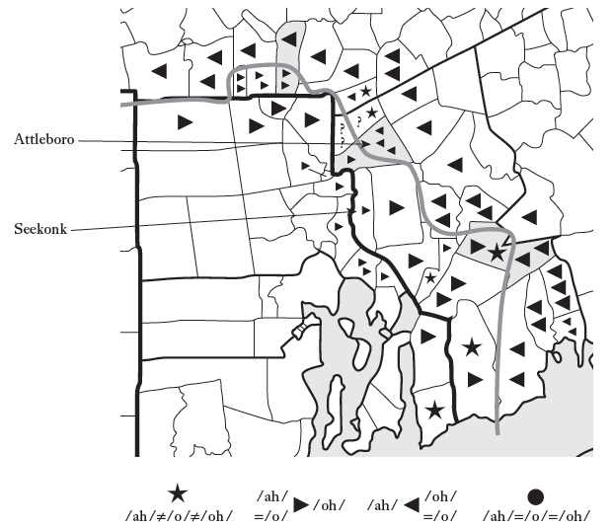
Notes:
In the area of eastern Massachusetts around Boston, there is a complete merger of /o/ and /oh/ in cot and caught, Otto and auto, etc. while in the region next to Rhode Island, this distinction is maintained. This is Johnson’s map of the boundary between the merged region on the right and the unmerged region on the left. He found that this boundary was stable across two or three adult generations but when he studied families in the border towns of Attleboro and Seekonk, he found a rapid shift towards the merger in the youngest generation.

Slide 19
Low back vowel systems in Seekonk children by grade and parental system. Elementary schools: A = Aitkin, M = Martin, N = North. (Johnson 2010: Fig. 5.3)
Notes:
Here the vertical axis shows Seekonk children’s grade in school, and along the horizontal axis are grouped the various families according to whether mothers, fathers, or both make the distinction.[CLICK I n grades 2-6 there is a belt of 10 black symbols indicating complete merger, while older children maintain the distinct system of the community and younger children have not completely emerged from the influence of their parents.

Slide 20
Distinctness scores for Attleboro 8th grade subjects cross tabulated by parents’ dialect origins (Johnson 2010)
distinct mother merged mother
distinct father 2.59 (N=24) 0.83 (N=6)
merged father 1.67 (N=6) 0.70 (N=37
Notes:
But although parents’ influence may be eroded, it is not eliminated immediately as children mature. We can trace the persistence of the waning influence of parents by comparing the relative influence of mothers and fathers. Since female caretakers are the primary source for first language learning, we can expect the effect of having a mother with a distinct system would outweigh the effect of a father with a distinct system. This table is drawn from Johnson’s School Survey in Attleboro. The figures register a distinctness score where 4 is maximum in children’s response to minimal pairs as ‘same’ or ‘different’. We see that having a mother who makes the distinction (but a father who doesn’t) yields twice as a high a distinctness score as the reverse situation
Johnson suggests that the erosion of the distinction is the result of new families moving into this area from The Boston region. Yang (2009) calculates that approximately 20% of such inmigrants would produce this result and the school populations in this area do show that proportion. Here the process of erosion of parental influence is documented most clearly when we see the incomplete result.

Slide 21
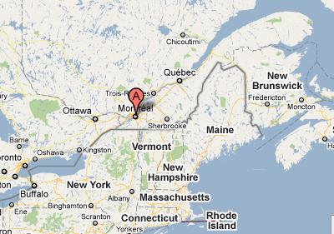
Montreal. . .
Notes:
We can now shift to a view of the rejection of parental influence by a slightly older group: adolescents. This is from Sankoff and Blondeau’s real-time re-study of the shift from apical to uvular /r/ in Montreal. The traditional Quebecois dialect of Montreal used consistent apical /r/ in [ruzj] CLICK The new uvular form spread geographically from the Quebec City area, though it was also identified with continental standard French.

Slide 22
Shift of apical to uvular [R] in Montreal (from Sankoff and Blondeau 2007)
Louise L.
Louis-Pierre R.
% [R]
Guy T.
Paul D.
Age
-- Sankoff & Blondeau 2007
Notes:
In this figure the percent uvular [R] is shown on the vertical axis and age of the speaker on the horizontal axis, Blue symbols show percent [R] in 1971 and the red symbols in 1984. The four black arrows connect the 1971 and 1984 values of speakers who increased their use of the uvular variant from some intermediate value in 1971.That is these for adolescents had not departed completely from their parents in 1971, but 13 years later, in 1984, they had done so. At upper left [CLICK] are seven black diamonds representing adolescents who had already achieved 100% uvular (R) by 1971 and maintained it in 1984.

Slide 23
Putative trajectories for speakers under 20 in 1971 who were already categorical [R]-users
% [R]
Age
-- Sankoff & Blondeau 2007
Notes:
The parents of these seven adolescents were part of a community that used 100% apical (r), In fact, when parents of these adolescents do appear in the recordings of the 1971 interviews, they use100% apical [r]. We conclude that 100% apical would have been their model in early L1 acquisition. It is clear that the majority of adolescent speakers in 1971 had taken as their target a form of /r/ quite distinct from that of their parents and 7 out of 12 achieved consistent control over this uvular form.
The pattern seen with relative influence of competing dialects is repeated with even greater clarity when the caretakers are not native speakers of the dominant language of the speech community. With the massive immigration into the U.S. from southern and eastern Europe in the late 19th century, large numbers of children acquired English in households where the caretakers were native speakers of Italian, Polish, Yiddish, Greek, and many other languages. Next I’d like to look at evidence for the eventual disappearance of such parental influence among adult speakers, using two different ways of assessing the influence of a parent’s foreign language on the final output. One is by comparing second and third generations, the other by a regression analysis of the effect of ethnicity.

Slide 24

The Lower East Side of New York City
Notes:
This is the Lower East Side, the location of my study of New York City phonology in the 1960s.. It was a common conception that somehow the dialect of New York City was influenced by the many mother-tongues of immigrants. However, the influence of parents’ language was regularly found to be the least of all sociolinguistic forces operating on children’s language here and in many aother cities. As we have seen, children have the capacity to detect at an early age, in ways that are not understood, the fact that their parents’ language is not fully representative of the speech community and so is not the proper target for their language learning.

Slide 25
. Phonological variables for subjects with foreign- and native-born parents in New York City
40 - high
10 - low
Notes:
This appeared most dramatically in a comparison that I made between second and third generation Jewish New Yorkers in the raising of the variables (æh) and (oh). The raising of (æh) carries [bæd] to [be: d] and [bi: d], while the raising of /oh/ carries [k fi] to k fi’. Both use a 4-point scale where 10 shows consistent low lax vowels and 40 shows consistent high tense ingliding vowels. Both of these sound changes run counter to the direct influence of Yiddish on English, which gives us lax [ə bɛd mɛn] in stead of tense [be:əd me:ən] and [ə kɒp kɒfi] instead of [ə kʌp kʊ:əfi]. This table shows the two generations, second and third for upper middle class Jewish younger men, and working class Jewish older women.
[CLICK] There are no significant differences between generations in the raising of (æh) [CLICK]. there were no significant differences between the 2nd and 3rd generations in the raising of (oh).. We see that the eventual result for young and middle aged adults is the same for children whose parents were speakers of Yiddish and those whose parents were native speakers of the New York City dialect.

Slide 26
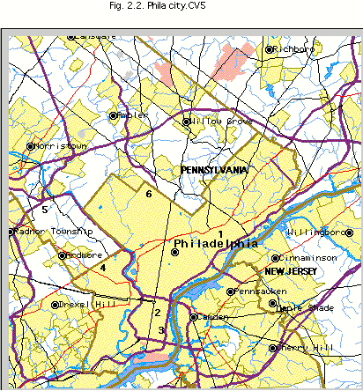
The Philadelphia Neighborhood Study [N=120]
Upper class Chestnut Hill
Nancy Drive King of Prussisa
WicketSt. Kensington
Mallow St. Overbrook
Clark St. So. Phila
Pitt St.: So. Phila
Notes:
This map locates the Philadelphia Neighborhood Study in the 1970s. This study created a stratified sample of the white mainstream areas of Philadelphia,with ten neighborhoods that embodied a full range of social classes and ethnicities.

Slide 27
Mean F1 and F2 for vowels with age coefficient in the Philadelphia Neighborhood Study 1973-1979 (Labov 2001)
Head of arrow = estimated value for speakers 25 years younger than the mean; tail of arrow for speakers 25 years older than the mean.
Notes:
The sound change we will consider is the raising and fronting of /ey/ in closed syllables, one of the new and vigorous sound changes in Philadelphi. In this diagram each circle shows the mean value of a given vowel for the whole community, and the arrow shows any significant age coefficients indicating change on the F1/F2 dimensions in apparent time. The head of the arrow represents the expected mean for speakers 25 years younger than the mean, the tail the expected value for those 25 years older than the mean. CLICK The vowel in question, checked /ey/ is shifting front and upward along the front diagonal

Slide 28
Stepwise regression analysis of second formant of F2 of checked /ey/ in the Philadelphia Neighborhood Study. N=112. Adjusted r² = 39.3.
Variable Coefficient Probability
Age (* 25 yrs) -85 ≤ 0.0001
Female 83 0.008
Upper working class 108 0.026
Wicket St. neighborhood 145 0.004
Jewish -169 n.s.
Italian 38 n.s.
Irish -2 n.s.
Wasp -91 n.s.
German -98 n.s.
Generational status 9 n.s.
Notes:
this table shows the results of a multiple regression of the fronting of checked /ey/ in the Philadelphia Neighborhood Study of the 1970s which arrived at this position.CLICK. [CLICK] Age disfavors the process—that is younger speakers have higher F2. [CLICK] Female gender favors the change. [CLICK] Membership in the upper working class favors the change. Residence in the Wicket St. neighborhood strongly favors it. [CLICK] But Jewish ethnicity is not a significant effect. [CLICK] Nor Italian. [CLICK] Nor Irish. [CLICK] Nor WASP. [CLICK] Nor German. [CLICK] have also added generational status to the list of independent variables: it is not significant, confirming the equivalence of second and third generations found in the New York City study. The erosion of parental influence is complete for this adult population.
The results for NYC and Philadelphia should not lead us to think that this is a universal result. If communication between ethnic groups is limited, with a high degree of residential segregation, we will see the persistence of ethnically inherited patterns. Boberg’s recent work on the English of Montreal demonstrates this. Even more plainly, the effects of racial segregation in the U.S. have led to the formation of two separate speech communities on a national scale. The evidence we have just seen applies only to the white mainstream population. The same rejection of parental influence emerges from data on the African American community, as in Wolfram’s studies of Hyde County, North Carolina the study of Springville, Texas by Bailey and Cukor-Avila. but with different variables and different data sets.

Slide 29
Part 2. Orientation to the community.
Notes:
We now turn to the obverse of Part 1: the embrace and absorption of the community pattern by those who are achieving adult-like control of language.

Slide 30
Tensing of short-a in Philadelphia in closed syllables
p t tʃ k
b d dʒ g
m n ŋ
f θ s ʃ
v ð z ʒ
l r
Notes:
I will first look at the acquisition of the well studied Philadelphia short-a split between tense nd lax short-a words. Tensing occurs generally in syllables closed by a remarkably unnatural class shown here: front nasals and voiceless fricatives. It should be noted that syllables are also closed by an inflectional boundary so that ham and hamming are tense, but hammer is lax

Slide 31
Tensing of short-a in Philadelphia in closed syllables
mad, bad glad
p t tʃ k
b d dʒ g
m n ŋ
f θ s ʃ
v ð z ʒ
Notes:
To this set we add short a before the voiced stop /d/, where lexical diffusion has crystallized in the tensing of three affective adjectives, [CLICK] mad, bad and glad, but not sad or any other word before /d/.

Slide 32
Tensing and laxing of short a before /d/ in the spontaneous speech of 112 adults in the Philadelphia Neighborhood Study, including speakers from all social classes
Tense Lax
bad 143 0
mad 73 0
glad 18 1
sad 0 14
dad 0 10
Notes:
This table shows the use of these words in spontaneous speech by the 112 speakers in the Philadelphia Neighborhood Study, from upper class Chestnut Hill to lower working class Kensington. There is one exception out of 234 tokens: a lax version of glad.
This distribution is not easy to learn even for the youngest children from out-of-state families in King of Prussia. In contrast to the learning of phonetic patterns, Payne found that only 1 of 34 children acquired the mad/bad/glad pattern. We note that our oldest lower class Irish speaker has the same system as our oldest Upper Class speaker. Given the fact that the children of out-of-state families in King of Prussia showed only partial learning of this pattern, and many out of state children move into the city across the decades, we have yet to understand how such uniformity across neighborhoods and social classes is achieved..

Slide 33
7,101 vowels of Jean H. PH06-2-1, 60 yrs
Notes:
This was the uniformity achieved across the whole population by 1979. Let us examine the current situation today, as reflected in a detailed analysis of the vowel system of a single speaker, Jean H., 60 years old, interviewed by Joe Fruehwald in 2006. This is the output of our current program for automatic vowel analysis, using the forced aligner of Jiahong Yuan and our development by Ingrid Rosenthaler and Joe Fruehwald of the Extract Formants programs initiated by Keelan Evanini. Here we display 7,103 vowels longer than 50 msec from an hour of Jean M’s speech. Let us consider the equestion, persistent is the mad, bad, glad pattern?

Slide 34
Tense and lax vowels before /d/ of Jean H
_æhd
_æd
Notes:
Here are her short-a words before /d/. There is a clear division between 15 tense tokens in spontaneous speech 12 lax tokens. What words are represented here?

Slide 35
Tense and lax words before /d/ of Jean H
Notes:
We have in the tense class

Slide 36
Lexical diffusion of short-a tensing in Philadelphia
Tense Lax
pan panning panel
ham hamming hammer
plan planning planet
fan fanning flannel
Notes:
Let us now consider a new development in the short-a split. In the Philadelphia Neighborhood Study of the 1970s, we found a tendency for a very few words with short-a before nasals in open syllables to become tensed. Most prominent was planet, which was surprising because short-a occurring after initial /pl/ will normally be found lower and further back than in other words.

Slide 37
Lexical diffusion of tensing of planet among adults and children in Philadelphia (Roberts and Labov 1995)
Notes:
Little children appear to have detected this trend and carried it further. In Roberts’ work in a South Philadelphia day care center in 1990, children 3-5 years old had advanced this level of tensing of planet to 93% compared with only 18% for adult in the 1970s.

Slide 38
Lexical diffusion of planet among younger and older children in Philadelphia (Roberts and Labov 1995)
Notes:
Roberts divided those children into a younger group of 3 year olds, and an older set 3:11 to 4:11, The advance of planet and its contrast with Janet is accentuated for the older group. In some way not yet clear to us, children are learning that the new form is tense planet, as compared to the older lax form [planet]..

Slide 39
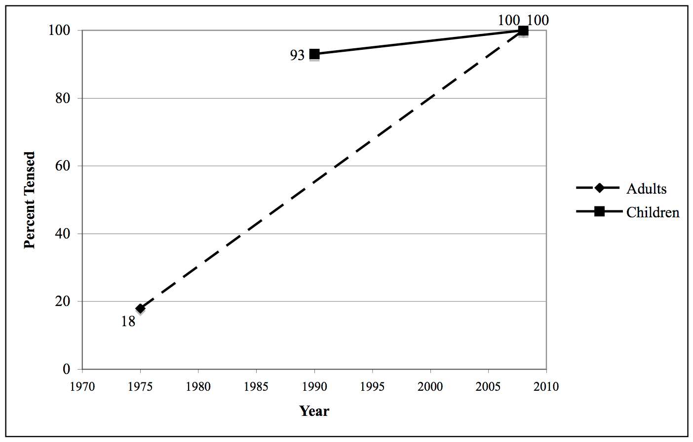
Advance of tensing of short-a in planet by adults and children in Philadelphia in 1975, 1993 and 2008 (Brody 2008).
Notes:
18 years later, in 2008, Stephanie Brody found a further advance to 100% planet among 4-year-old children in a similar South Philadelphia day care. By this time, their adult parents had also reached 100%.

Slide 40
Tensing of short-a in Philadelphia before laterals
p t tʃ k
b d dʒ g
m n ŋ
f θ s ʃ
v ð z ʒ
l r
pal
Sal
Alice
Italian
personality
alligator
mallet
alley
. . .
Notes:
A further expansion of the tensing environments for short-a is the pre-lateral set, in both open and closed syllables: pal, Sal, Alice, Italian, personality, alligator, mallet, etc. These two showed lexical diffusion in the 1970s and are seen to be moving on to completion in other studies

Slide 41
Short-a before /l/ in the vowel system of Marie C., 62, [1973], Philadelphia
/æh/
/æ/
Notes:
To get an idea of the consistency with which individuals participate this pattern This is a selection from our new automatic analysis of 9,000 vowels of a 62 year old woman recorded in 1973. Only four of 35 short-a words before /l/ have moved up to the lower area of tense /æh/.

Slide 42
Categorical shift of /æ/before /l/ from lax to tense category in the vowel system of Jean H.,60 [2006], Philadelphia
Notes:
Here is the 60 year old Jean H. again recorded 33 years later. She showsthat 34 out of 35 words\before /have moved up and front, leaving that one token of PERSONALITY behind.

Slide 43
Tensing of short-a before /l/ by adults and children age 3 – 5 in three South Philadelphia families (Brody 2008)
 | Family 1 | Family 2 | Family 3
Adults | 8/8 | 0/7 | 4/14
Children | 4/4 | 1/6 | 6/7
Notes:
Brody’s recent study of children in South Philadelphia day care focuses on the development of short-a before /l/ in three families. One family is quite advanced for both children and adults: 8 out of 8 and 4 out of 4. In a second family, the adults show no tensing and for the child, only a single case of tensing. In a third family, the adults show only a moderate tendency. 4 out of 14, but the children are close to 100%. Thus it is clear that in this case, parental influence is still a factor even as children move away from that parental pattern tpwards the incoming new pattern.

Slide 44
The raising of Philadelphia /ey/ in closed syllables in bait, laid, fade, etc.
Notes:
Let usre turn to a variable that represents not lexical diffusion, but the more common type of change in progress: regular Neogrammarian change that affects every vowel in the class: the fronting and raising of checked /ey/ in bait, laid, fade, etc. to pverlap with /iy/ in beet. lead, feed.

Slide 45
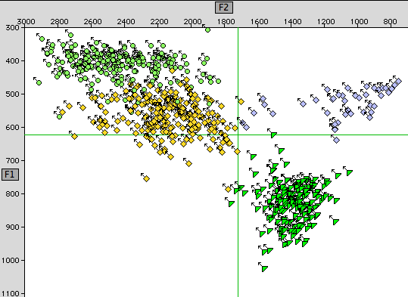
Raising of /ey/ for Jean M., 60, Philadelphia [2006]
iy
ey
oy
ay
Notes:
The current state of this development may be seen in the vowel system of our 2006 speaker, Jean H., We observe that the 204 tokens upper mid vowel /ey/ are relatively front and high, encroaching on /iy/ but quite distant from /ay/.

Slide 46
Social stratification of (eyC) in Philadelphia Neighborhood Study [N=112]
Notes:
This is the curvilinear social pattern that emerged in the 1970s. The vertical axis is the second formant of /ey/, and the columns display six socio-economic classes. The upper working class is in the lead. [CLICK] We want to know, what are the relations between this leading group and the neighboring groups that leads the change to expand throughout the community?

Slide 47
The social motivation of sound change by individual “Acts of Identity” --R. Le Page & A. Tabouret-Keller 1985
The individual creates his systems of verbal behavior so as to resemble those common to the group or groups with which he wishes from time to time to be identified, to the extent that:
(a) he is able to identify those groups
(b) his motives are sufficiently clear-cut and powerful
(c) his opportunities for learning are adequate
(d) his ability to learn -- that is, to changes his habits where necessary -- is unimpaired.
--R. Le Page & A. Tabouret-Keller, Acts of Identity (1985)
Notes:
One view is that this dispersion throughout the community is the result of individual decisions to align with a local pattern. This is well developed in Le Page and Tabouret-Keller’s book, Acts of Identity.
The individual creates his systems of verbal behavior so as to resemble those common to the group or groups with which he wishes from time to time to be identified, to the extent that:
(a) he is able to identify those groups
(b) his motives are sufficiently clear-cut and powerful
(c) his opportunities for learning are adequate
(d) his ability to learn -- that is, to changes his habits where necessary -- is unimpaired.

Slide 48
Scatterplot of the fronting of (eyC) by age and socioeconomic class, with partial regression lines for social classes, from the Philadelphia Neighborhood Study 1972-1979 [N=112].
Upper working class
Upper class
Notes:
Let us apply this thinking to a scatterplot that displays on the vertical axis the second formant of /ey/, registering the degree of fronting, for all 112 subjects of the Philadelphia Neighborhood Study. the horizontal axis is age. It is clear that there is change in apparent time. the six lines are partial regression trend lines for each of the six social classes. [CLICK] The solid black line is for the leading group, the upper working class. Exactly parallel is the lowest, dashed line [CLICK] that represents the trend for the upper class. Let us see what the implications are for the explanation through individual acts of identity. It would have to be argued that the members of the upper class have made individual decisions about their vowel production, conscious or unconscious, in a way that allows them to be identified with members of the upper working class—or perhaps the upper middle class, for it makes no difference which group you choose. We learn from Tony Kroch, who did this part of our study in 1979, that this group has a high degree of class consciousness. One girl who referred to herself as “middle class” was told by her mother, “You are not middle class. You are upper class.” The notion that they are moved as active agents to identify themselves with lower status groups is simply not tenable. Yet it is apparent that the upper class speakers (black dots) show a shift in the very same direction as the rest of the community when we compare the older speakers [CLICK] with the younger [CLICK]. It is clear that some driving force is acting on the community as a whole.

Slide 49
The backing and fronting of /ʌ/ in bus, but, bunk, etc.
Notes:
I would like to turn know to another sound change operating at a more distant part of the United States. I can best illustrate it by asking you to serve as subjects in a replay of experiments we conducted on cross-dialectal comprehension.

Slide 50

Cross-Dialectal Comprehension Gating Experiments: Chicago
Word Phrase Sentence
1. _________ ________________ ___________________________
2. _________ ________________ ___________________________
3. _________ ________________ ___________________________
4. _________ ________________ ___________________________
5. _________ ________________ ___________________________
6. _________ ________________ ___________________________
Notes:
In these experiments, we first present subjects with single words extracted from spontaneous speech. For a moment, you are the subject: what word do you hear? PLAY Now listen to the same word embedded in in a larger phrase PLAY Finally, you hear in the full sentence PLAY.
At this point most, but not all listeners, realize that this sound change has led the speaker to pronounce the word busses the way they pronounce bosses.

Slide 51
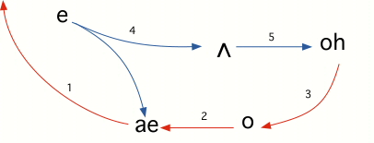

The Northern Cities Shift
desk
busses
mat
head
boss
block
socks
Notes:
Who speaks in this way? This shifting of wedge in busses, but, bunk to mid-back position is part of the well known Northern Cities Shift. along with the rotation of five other vowels. play BUSSES
.

Slide 52

Belten high school in the suburbs of Detroit (Eckert 2000)
Notes:
One place we can go to hear this phenomenon is the Detroit area. The most detailed study of the backing of short-u was done by Penny Eckert in a suburban high school in the late 1980s.

Slide 53
Backing of / ʌ / in but, bunk, etc. by gender and social group in Belten high school in the suburbs of Detroit (Table 5.7, Eckert 2000).
Factor weights for advanced tokens of backed /ʌ/
Burnout girls Burnout boys Jock girls Jock boys
.79 .63 .22 .30
Notes:
This table illustrates Eckert’s location of the backing of wedge with membership in the local group of Burnouts as opposed to the Jocks. The numbers are the logistic regression factors that favor the use of strongly backed tokens of short-u. In Eckert’s analysis of high school social structure, the Jocks are that polar group that conforms most closely to adult norms, in student government, performing arts and varsity athletics, while Burnouts deviate from those norms and adhere to opposing social practices of smoking, drinking, drugs and cruising
Though gender makes a difference here, Burnout status is by far the strongest effect.

Slide 54
The fronting of /ʌ/ in but, bunk, etc. in a Farmer City, Illinois high school (Habick 1980) ,
Notes:
Another study of short-u in the vowel systems of high school groups was carried out by Tim Habick in Farmer City, Illinois a few years before eckert’s study..

Slide 55
Distribution of fronting of /ʌ/ in but, bunk, etc by social groups in Farmer City, Illinois (based on Table 9-2, Habick 1980)
Distance from /e/
Group Overlapped Close Far
Burnout 6 3 0
Redneck (=Jocks) 3 6 1
Notes:
Here are Habick’s findings for the shifting of the same phonological element, short-u. The Farmer City Burnouts move the vowel in the opposite direction from the Detroit Burnouts, shifting it forward so that bunk is close to benk, as shown by the fact that 6 out of 9 speakers overlap the two classes. The opposing conformist group, here called “Rednecks”, show an opposite distribution, with only 3 out of 10 overlapping. These two studies of local communities of practice by Eckert and Habick suggest that the sound changes in question are the products of children‘s orientation to local norms as they emerge from the influence of their parents.

Slide 56
Distribution of fronting of /ʌ/ in but, bunk, etc by social groups in Farmer City, Illinois (based on Table 9-2, Habick 1980)
Distance from /e/
Group Overlapped Close Far
Burnout 6 3 0
Redneck (=Jocks) 3 6 1
Notes:
Here are Habick’s findings for the shifting of the same phonological element, short-u. The Burnouts move the vowel in the opposite direction, shifting it forward so that bunk is close to benk, as shown by the fact that 6 out of 9 speakers overlap the two classes. The opposing group, here called “Rednecks”, show an opposite distribution, with only 3 out of 10 overlapping. These two studies of local communities of practice by Eckert and Habick suggest that the sound changes in question are the products of children‘s orientation to local norms as they emerge from the influence of their parents

Slide 57
Distribution of fronting of /ʌ/ in but, bunk, etc by social groups in Farmer City, Illinois (based on Table 9-2, Habick 1980)
Distance from /e/
Group Overlapped Close Far
Burnout 6 3 0
Redneck (=Jocks) 3 6 1
Parents 1 2 4
Grandparents 0 1 5
Notes:
In Farmer City, we find spme evidence for this in the fact that parents and grandparents show a very different stage, with short-u far from short-e.

Slide 58
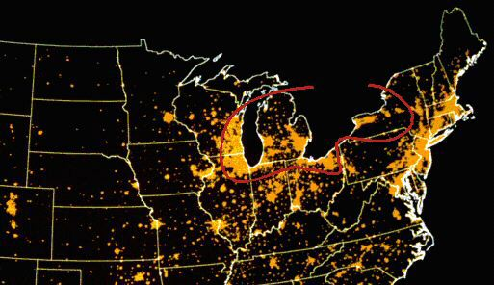
U.S. at Night
The Inland North
Grand Rapids
Milwaukee
Syracuse
Chicago
Rochester
Flint
Buffalo
Detroit
Kenoshat
Cleveland
Joliet
Omaha
Toledo
Columbus
St. Louis
CIncinnati
Indianapolis
Kansas City
Notes:
We might try to explain these phenomena as the work of individual agents who signal their adherence to by local communities of practice by adopting a local sound change. But what local communities? The Northern Cities Shift is not characteristic of Detroit, but extends over a vast area of 88,000 square miles affecting 34 million speakers: Syracuse, Rochester, Buffalo, Cleveland, Toledo, Detroit, Flint, Grand Rapids, Chicago, Joliet, Kenosha, Milwaukee. On the other hand, the fronting of wedge is not a feature of Farmer City, but is found in Columbus, Cincinnati, Indianapolis, Kansas City Omaha.

Slide 59
U.S. at Night: u in bunk
The Inland North vs. the Midland: short u in bunk
Milwaukee
Syracuse
Flint
Columbus
Terre Haute
Indianapolis
Evansville
Notes:
Let us listen to the short-u vowel in the word bunk in a variety of Northern cities Milwaukee .. .
and then the opposite trend towards short-e in four Midland cities Columbus. . .

Slide 60
Uniformity of the Inland North as defined by four coinciding isoglosses. Black symbols: speakers satisfying the UD criterion: /ʌ/ is backer than /o/. White symbols: /o/ is backer than /ʌ/
NORTH
NORTH
MIDLAND
MIDLAND
Notes:
In the Northern Cities Shift, short-u moves back and short-o moves forward. and so the relative positions of these two vowels are reversed from that of the Midland. In this map from the Atlas of North American English the black circles represent speakers for whom the mean short-u is backer than mean short-o. The white circles are the opposite: mean short-u is front of mean short-o. In the Inland North, the inner isogloss in which the Northern Cities Shift is dominant, there are only three white circles. South of the North/Midland boundary, there are practically no black symbols, except for the corridor leading down to St. Louis, where northern influence has recently expanded. Again, we ask, what are the forces that lead to such extraordinary uniformity?

Slide 61
The prevalence of out-of-state neighbors for Atlas subjects: Percent non-locals answering telephone in four city/regions
Source: Table 14.3, Atlas of North American English
Notes:
the uniformity of our regional dialects is even more surprising when we consider the residential instability of the American landscape. This diagram taken from the Atlas data shows the percent of people who answered their telephones but were not local ranging from 22 to 77%. In any region it is high enough to guarantee that the speakers we recorded, and produced this uniform record, grew up next to families from elsewhere, whose children spoke a different dialect, as in King of Prussia Unless there is some overall drive to eliminate idiosyncratic practices in favor of a general consensus, the dialect maps of the U.S. would be a pepper-and-salt pattern, not the black and white uniformity of the last slide.

Slide 62
Increasing divergence of /ʌ/ on the front-back dimension along the North/Midland boundary
Notes:
The expansion of a particular set of sound changes to a larger speech community raises the problem: what are the limits of that community? and how are they set? Several chapters of the third volume of Principles of Linguistic Change deal with the historical and social motivation for these limits. But for the moment, we’ll take them as we find them, much as the child language learners do.

Slide 63
The coalescence of nine isoglosses on the North/Midland boundary
NORTH
MIDLAND
Notes:
This closer view emphasizes even more the categorical division between the North and the Midland. But within the North there is a continuum of backing of short-u and within the Midland a continuum of fronting of short-u.

Slide 64
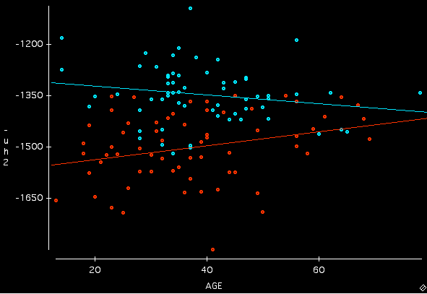
Backing and fronting of /ʌ/ in STRUT by age in the Inland North [blue] and the Midland [red]
d
F2(ʌ)
d
Notes:
This scattergram shows the second formant of short-u on the vertical axis. Low F2 sounds like PLAY and high F2 sounds like PLAY. Age appears on the horizontal axis. The blue and red lines are the trendlines for the North and the Midland. [CLICK] For the oldest speakers, there is no difference. [CLICK] For the youngest there is no overlap.

Slide 65
Every speaker is constantly adapting his speech-habits to those of his interlocutors.
(Bloomfield 1933: 476)
Notes:
At this point, one is tempted to look at the well known quotation from Bloomfield, which aims to explain dialect boundaries as minima in the network of communication. So far we have reason to doubt the universality of this principle. children talk very often to their parents, but do not adapt their speech habits to them. But perhaps people in the Midland don’t talk that often with people in the North. Is there a communication gap between the North and the Midland?

Slide 66
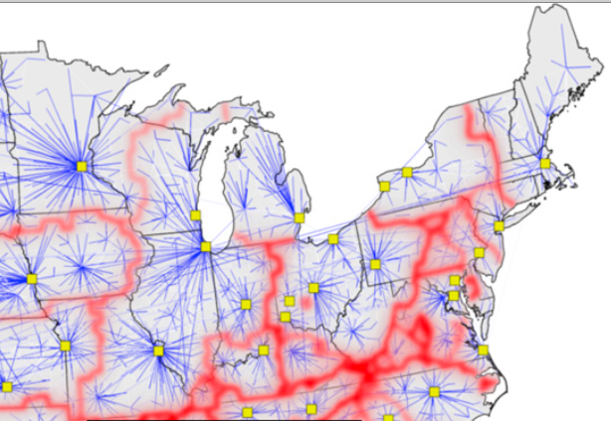
Border identification based on currency flux. Blue = modularity maximum. Links are drawn from the frequency with which they appear in shortest-path tree clustering. Red =height in the clustering tree. (from Thiemann et al. 2010, Figure 4b).
North/Midland
Notes:
Here is the most recent effort to trace patterns of communication across the United States. It is the work of Dirk Brockmann and colleagues, based on the analysis of the flow of nine million dollar bills as collected on the web site wheresgeorge.com. The red lines show communication boundaries, the blue lines modularity maxima. If we superimpose the North/Midland boundary on this map [CLICK] it is clearly orthogonal to lines of communication except in northern Pennsylvania.
In any case, we find that the local pattern identified by Eckert in Detroit is not local, but a general pattern covering 88,000 square miles and 34 million speakers. The local pattern discovered by Habick in Farmer City is not local but characteristic of the entire Midland area.
The definition of what is general is radically different in these two regions. We must assume that whatever the social significance of the backing of short-u, it is radically different for children in the North and children a few miles away across the Midland boundary. When a basketball team from Columbus Ohio meets a basketball team from Toledo Ohio, there is something about the linguistic contact that just doesn’t take.

Slide 67
Expansion of the new verb of quotation be like to the general English speech community
Notes:
Up till now I have dealt only with phonetic and phonological change, since those are the active changes in progress in North America. The last major change in English grammar seems to have been the development of the progressive in the 19th century (Arnaud 19??) which now appears to be common property alll English dialects. I would like to look briefly turn to the expansion of linguistic change to the largest definition of the speech community that is change that reaches all native speakers of the language. It is a small change, the grammaticalization of the new verb of quotation, A which everyone in this room is aware of.

Slide 68
First notice of the new verb of quotation, be like, in a note by Ron Butters in American Speech 57:149, 1982.
Notes:
This is the first published notice of this change.

Slide 69
The first recorded use of the new verb of quotation, 1983
I think people that -- have tr- never tried it are like more against it. Because, before I didn’t try it, I was like, "What's this gonna do to me?" You know.
--Ellen C., 20, Two Street, Philadelphia, 3/26/83
Notes:
In our year-by-year studies of the Philadelphia speech community, from 1973 to 2008, the first recorded use of the new verb of quotation is from 1983.
I think people that -- have tr- never tried it are like more against it. Because, before I didn’t try it, I was like, "What's this gonna do to me?" You know.

Slide 70
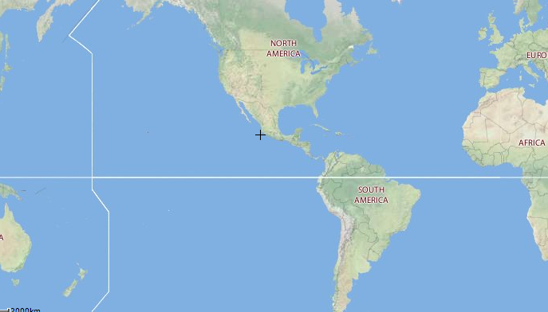
Reports of the new verb of quotation be like, 1983-2010
2001 Glasgow
1999 York
2004 Toronto
2004 Newcastle
1999 Ottawa
2001 MI
2004 St. John’s
1990 NY
2007 California
1983 Phila
2002 L.I.
1995 Texas
2001 Phila
2002 Texas
2010 NEW ZEALAND
Notes:
Many people who teach introductory linguistics have gathered reports on the new verb of quotation. On this map I have located all the published reports I am aware of.

Slide 71
Development of be like in Toronto in apparent time Figure 2 from Tagliamonte & D’Arcy 2004
say
5-9 yrs 1983
parental influence
10-14 1983
be like
Notes:
This diagram is taken from Tagliamonte and Darcy’s study of the verb of quotation in Toronto in 2004. The dramatic replacement of say by be like as the major verb of quotation is evident. [CLICK] Note that the 30-34 year old group, where be like almost equals say, was 10-14 years old in 1983, the current best guess for the origin of be like. [CLICK] The 25-29 year old group was 5-9 years old at that at time, the first group for which be like predominates at the expense of say. This argues that be like was in its first development in Toronto at almost the same time as in Philadelphia, or that this new form spread with lightning speed across the United States from wherever it originated. I should add that there is no evidence as yet that the new verb of quotation was propagated in the mass media before it became generalized in every-day life.
The adolescent peak shown here and in other Toronto studies conforms to the theoretical model of language change in PLC Vol. 2, in which language learners only gradually emerge from the parental level that they first acquired, following a logistic model of increase until the end of the critical period.

Slide 72
What is to be learned?
The general
The new
The local
The first
Notes:
Here then is a schematic map of what is to be learned. [CLICK] A central core is the parental pattern, the first language, which as we have seen is largely overwritten in youth but more completely so in adulthood.. CLICK Then there is the attraction of the local peer group or CLICK In the long run, this turns out to be a minor ripple in the larger current of new linguistic change. CLICK Finally, we find the tendency for the new to expand to the general: that parental, local and new influences are all dominated by the drive of the language learner to avoid the idiosyncrasies of local groups and acquire a form of language that is most useful for general communication.
Though I have suggested that the human language faculty has evolved to favor generality in communication, I would not want to argue for this to be a built-in biological bent for generality. Rather I would like to take a few minutes to sketch a social mechanism that achieves that result, one that is not entirely disconnected from biology.
.

Slide 73
The role of gender
Notes:
Where then do social relations play a role in this generalization? To pursue this matter, we should take note of the fact that gender differentiation is involved in the great majority of the linguistic changes that have been studied in progress with women in the lead in all but a few cases. Furthermore, we observe a progression, with gender becoming increasingly important as the change progresses.

Slide 74
Gender and social category determination of five elements of the Northern City Shift in a Detroit suburban high school
æ
^
Source: Eckert 2000
Notes:
This diagram displays are the findings of Eckert for all five of the stages of the Northern Cities Shift. The vertical axis is the percent of advanced tokens in the sound change. At extreme right is the most recent changes with social group differentiation: as we have seen, the backing of wedge is primarily a Burn-out phenomenon--red vs. blue symbols for the Jocks. As we move leftward, to older and older stages of the chain shift, gender differentiation—triangles vs. squares—replaces group identification. The oldest stage, the raising of short-a, is entirely a matter of gender. As in the great majority of changes, females are in the lead. Analysis of the data from the Atlas of North American English confirms these trends.

Slide 75
Mean gender differences in F1 and age coefficients for seven Philadelphia sound changes. ..
Notes:
This chart shows the relation of gender differentiation and the progress of six sound changes in Philadelphia that involve raising or falling as measured by first formant values. The open circles are gender coefficients; the solid symbols are age coefficients times 20. The two values rise and fall together as we move from incipient changes on the left to new and vigorous changes in the middle and completed changes on the right.

Slide 76
Mean gender differences in F2 and age coefficients for seven . Philadelphia sound changes..
iyC eyC aw ay0 æhN æh$ ahr
incip / new / old /completed
sex differences in F2 means
|age coefficient * 30|
Notes:
This chart shows the corresponding figures for seven sound changes involving second formant differences to register degrees of fronting or backing. These and other data have led me to put forward a mechanism of generalization that involves gender as an intervening variable

Slide 77
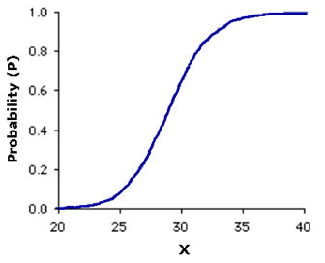
The generalization of linguistic variation
association with the general
language acquisition
association with gender
language acquisition
association with a social group
Notes:
Here then is a proposal for a sociolinguistic mechanism of generalization. Sociolinguistic variation is seen as an opportunistic process that reinforces social distinctions by associating them with particular linguistic variants. [CLICK] The use of linguistic forms to increase distinctiveness of particular groups does appear initially as a driving force for the acceleration of change. [CLICK]
The major acceleration of diffusion within a community is the result of the reinterpretation of social category differences as gender differences. Child first language learners have little experience with social stratification, but there is massive evidence that gender differences are salient for them. [CLICK] On the other hand, once a linguistic variable has become gender oriented, it is subject to another stage of reinterpretation. A male child’s first introduction to language is primarily from a female caretaker. It appears that as sound change goes on, he will not recognize that his mother is using a characteristically female form, but simply adopt it as the general form for the language. Thus we obtain many examples of male/female differentiation that show women a generation ahead of men but men closing the gap at the end.

Slide 78
The devoicing of (ll) in Buenos Aires Spanish by age
Source: Wolf & Jiménez 1975
Notes:
This shows the the work of Wolf and Jimenez on devoicing of /ll/ in the Spanish of Buenos Aires. The vertical axis is the percent devoicing of llama from [dzama] to [chama]. Women are strongly in the lead for the first two generations but the gap is closed among the youngest males.

Slide 79

A Sui village in southwest China.
Notes:
Cultural considerations can intervene abruptly in this scenario. James Stanford’s work among the Sui of southwest China shows a striking reversal of the role of mother’s and father’s speech in an exogamous patrilocal community where many women from a Northern dialect marry and move to a Southern dialec region. Stanrod shows that the father’s dialect is culturally enforced and children undergo great pressure to abandon the forms they first learned from their mothers.

Slide 80
Language learning target bound to father’s system among the Sui
me² tsop⁷ ni⁴ ow¹ tsop⁷ pu⁴
not be-like mother should be-like father
Stanford, James N. 2009. "Eating the food of our place": Sociolinguistic loyalties in multidialectal Sui villages. Language in Society 38:287-310.
Notes:
This patrilectal norm is available for public discussion; there is a stereotyped saying applied to speech:
me² tsop⁷ ni⁴ ow¹ tsop⁷ pu⁴
not be-like mother should be-like father

Slide 81
Northern 1st sg. Pronoun ɛj² vs. Southern ju²
He only says ɛj². If he said ju² people would laugh at him, ‘You speak like your mother.’ They would laugh, and he would be embarrassed. He’s not willing to speak like his mother. He speaks like his father. (p. 572)
“They said ɛj². If they said ju², then others would scold them. ‘You eat our food, but you aren’t like us.”
Notes:
A South-speaking married woman living in the North said of her 14 year old son:
He only says ɛj². If he said ju² people would laugh at him, ‘You speak like your mother.’ They would laugh, and he would be embarrassed. He’s not willing to speak like his mother. He speaks like his father. (p. 572
Another woman said of her children”
“They said ɛj². If they said ju², then others would scold them. ‘You eat our food, but you aren’t like us.”
Stanford’s thesis is that the language learning of Sui children is directed to a particular group of speakers. Here the group of women from any outlying dialect or children influenced by them are excluded as models. This is one of many specific cultural configurations that the language learning capacity will confront. The target of language learning can be culturally determined, rather than follow automatically a preference for peers over parents. The Sui case makes explicit some of the mechanisms that lead to uniform behavior and suggests that the selection of the target group may also be defined by social processes in New York City and Philadelphia as well.

Slide 82
Conclusion
Notes:
We then have gained some idea of what is to be learned, and how the language learner looks outward to master the broader community patterns. The study of linguistic variation is sometimes pursued as a way of showing how different people are from one another. And it is perfectly true that the larger our data base becomes, the more often will statistical analysis reveal subtle differences among subgroups of the population. I have tried to turn the focus away from those minor subdivisions and ask us to account for the breathtaking uniformities that result from the outward orientation of the language learning faculty. Though we have much to learn from micro-analysis, we have more to learn from our efforts to grasp the larger picture.
On the whole, we cannot doubt the importance of studying linguistic variation in face-to-face interaction. Recent ethnographic work has illuminated our understanding of how linguistic influence flows across social networks, and how the face-to-face negotiation of personal identity accelerates the shift of targets in the course of change in progress. But the larger uniformities shown here, in both the slope of variation and the structural base for variation, require further inquiry into what the language learners must know.
This does not mean that everyone in a community will ultimately be speaking the same way. On the contrary, these new waves of sound change are differentiated in vast regions which are becoming progressively more different from each other. [The general is defined in many ways by language learners; but it is currently defined as the regional in preference to the local. At an earlier period, the same unifying tendency extended to the limits of smaller speech communities, respecting the limits of the village, the town or the city. The cultural and historical factors that dictate the limits of the community expansion are another and larger part of the story.]
Along with those uniformities we find abrupt discontinuities between black and white, North and Midland, Canada and the U.S. But we do not know enough about how the great divisions between these regional dialects are maintained. Somehow, high school students in Midland cities must understand that the peers they meet from Northern cities are not models of linguistic influence: they are playing a different game with different rules and different stakes. For each such division, we can search for a first explanation in the absence of communication among language learners. Given no such discontinuity, explanation may be found in the compatibility or incompatibility of the linguistic structures involved. The third possibility is inhibition from opposing cultural values associated with these linguistic differences. This is the main topic of Chapters 10 and 11 of the 3rd volume of Principles of Linguistic Change, appearing this month.
[The problem was confronted by Fridland (2000) when her study of Memphis showed the same trend of glide weakening of /ay/ across white and black populations, though there was very little communication between them. Searching for the social base for such uniformity, she argued that “these shared practices do not necessarily require individuals’ social cohesion but merely require shared historical experience and a strongly circumscribing environment that places speakers in a similar social position relative to the external social world.” These are the cultural factors that the cognitive apparatus of the language learner must grasp. The same argument applies to the uniformity of the direction of linguistic change in metropolitan communities like Philadelphia and in the Inland North as a whole. ]
The evidence that I have presented here is drawn from phonetic and phonological change, because those are the changes in progress that are taking place around us. But I have no reason to think that similar orientation to generality are not found in other domains of language structure.
This presentation has put forward the concept that language is developed and evolved as an instrument for wider communication and the language learner is dominated by that framework for learning. Some language features are co-opted as symbols of local identity. But the larger pattern for the language learner is for the new to overwhelm the local and then expand to the limits of that general speech community that is the primary target of the language learner.

